Slide 1
ANALYZING EMS
RESPONSE TIME
PRESENTED BY
ROSHAN NIRANJAN KALPAVRUKSHA
TEJOMAY K
VINDYA SREE KANCHI
KAMALAESH KATARI

Slide 2

INTRODUCTION
EMS stands for Emergency Medical Services, a system providing immediate medical care in Emergencies.
Analyzing EMS incident dispatch data allows us to understand response patterns, assess service efficiency and identify areas for improvement.
It contains records of EMS incidents, including dispatch times, incident types, locations, and units dispatched.

Slide 3
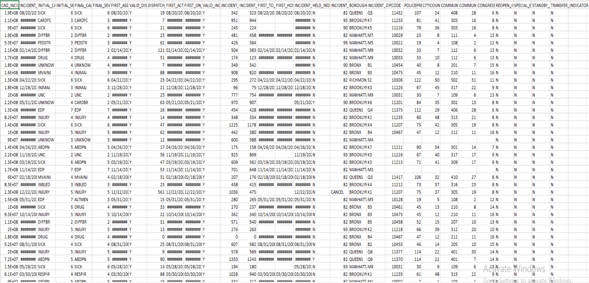
DATASET

Slide 4
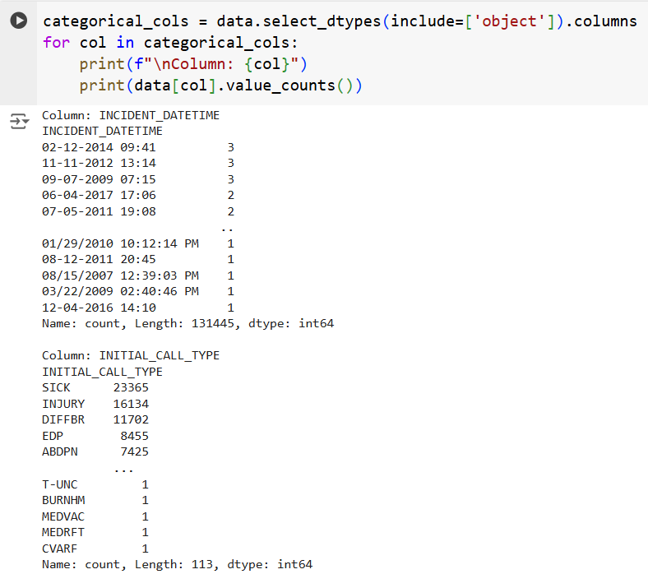
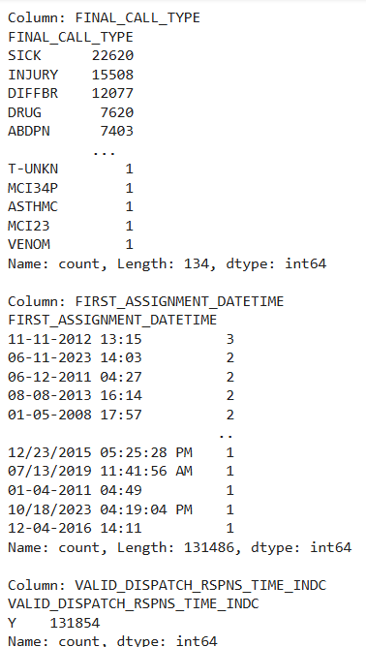
CATEGORICAL VARIABLES ANALYSIS

Slide 5
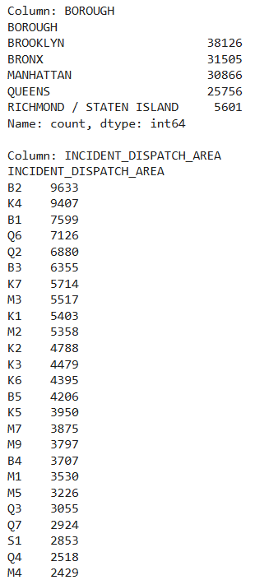
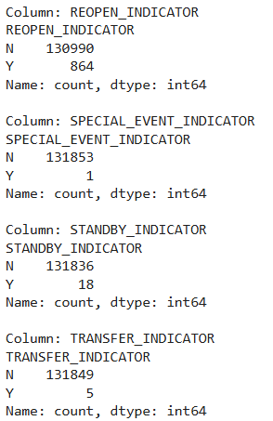
CATEGORICAL VARIABLES ANALYSIS

Slide 6
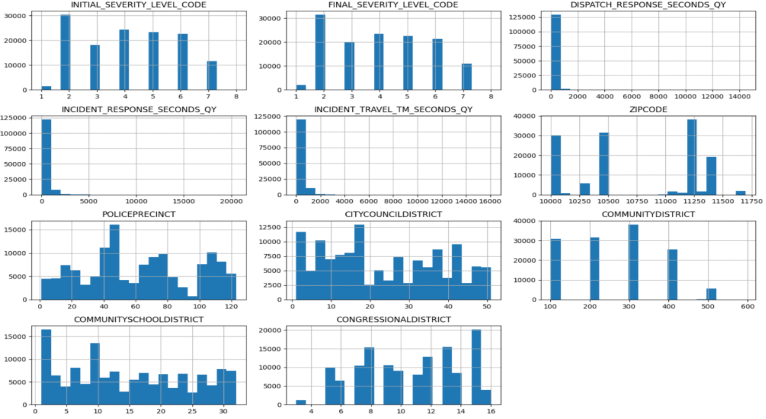
DISTRIBUTIONS OF NUMERICAL COLUMNS

Slide 7
DISTRIBUTIONS OF NUMERICAL COLUMNS
The INITIAL_SEVERITY_LEVEL_CODE and FINAL_SEVERITY_LEVEL_CODE show a skewed distribution, with lower severity levels being more frequent.
INCIDENT_RESPONSE_SECONDS_QY and DISPATCH_RESPONSE_SECONDS_QY indicate that most incidents and dispatch responses occur within shorter time frames. The distribution has a sharp peak near lower times and long tails, suggesting outliers or extreme cases.
Certain ZIP codes appear prominently, indicating that specific areas may experience more incidents than others. For example, peaks around 10500, 11000, and 11500 stand out.
The CITYCOUNCILDISTRICT distribution reveals variability in the number of incidents, with certain districts having a significantly higher frequency.
COMMUNITYDISTRICT displays a clear imbalance, with specific districts such as 200 and 400 having a disproportionately higher number of incidents compared to others.
The clustering seen in ZIP codes, precincts, and districts suggests that geographic or jurisdictional factors significantly influence incident distribution and response characteristics.

Slide 8
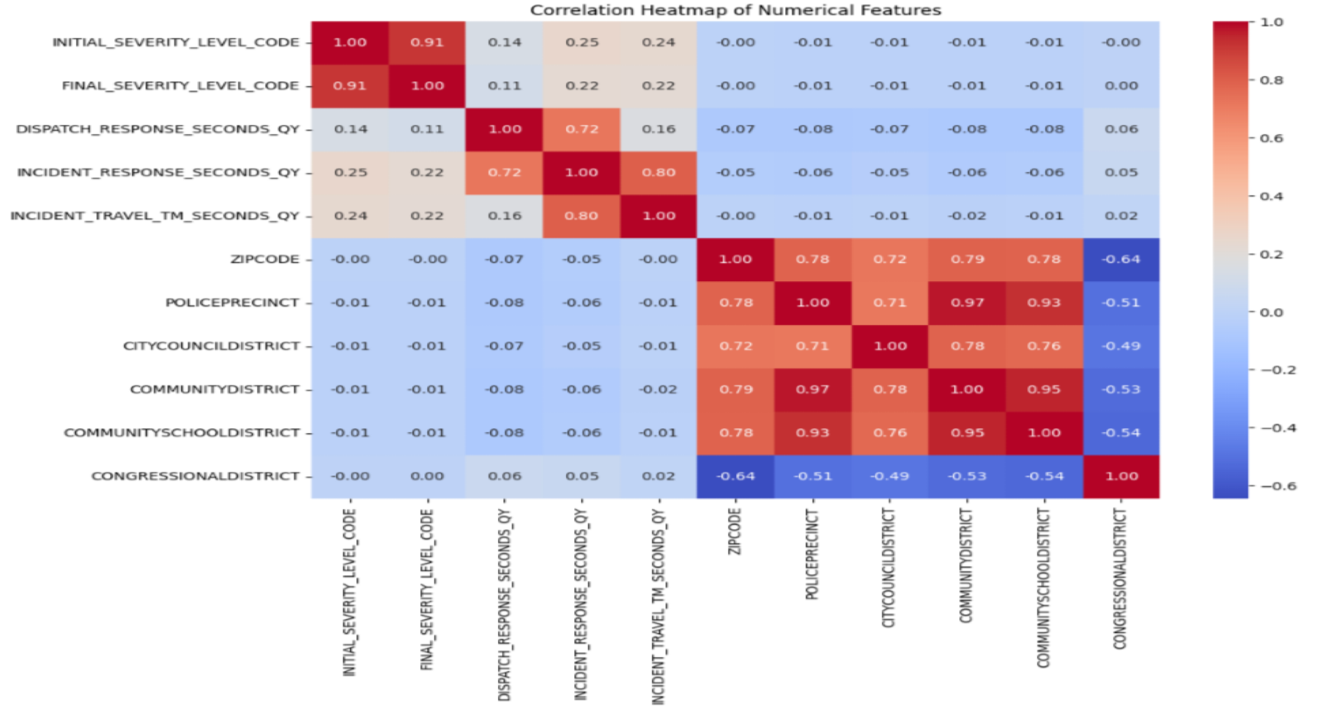
INITIAL_SEVERITY_LEVEL_CODE and FINAL_SEVERITY_LEVEL_CODE show a very high correlation (0.91), indicating that initial severity levels are closely related to the final outcomes.
INCIDENT_RESPONSE_SECONDS_QY & INCIDENT_TRAVEL_TM_SECONDS_QY exhibit a strong positive correlation (0.80), suggesting that incidents with longer response times also tend to have longer travel times.
CORRELATION HEATMAP

Slide 9
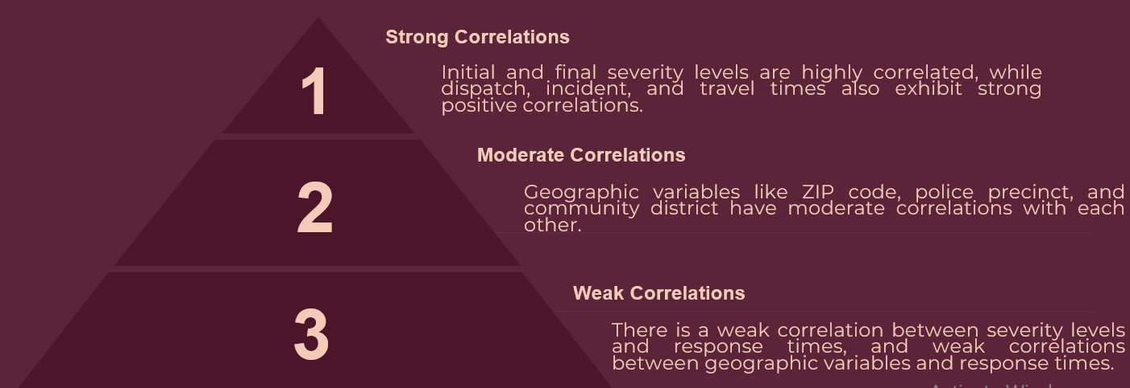
CORRELATION HEATMAP
ZIPCODE, POLICEPRECINCT, CITYCOUNCILDISTRICT, COMMUNITYDISTRICT, and COMMUNITYSCHOOLDISTRICT are highly correlated with each other (above 0.70), implying strong geographic overlaps or dependencies among these variables.
CONGRESSIONALDISTRICT shows a negative correlation with ZIPCODE (-0.64) and other location-based features, which may indicate differences in jurisdictional boundaries.

Slide 10
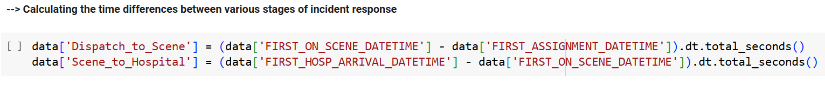
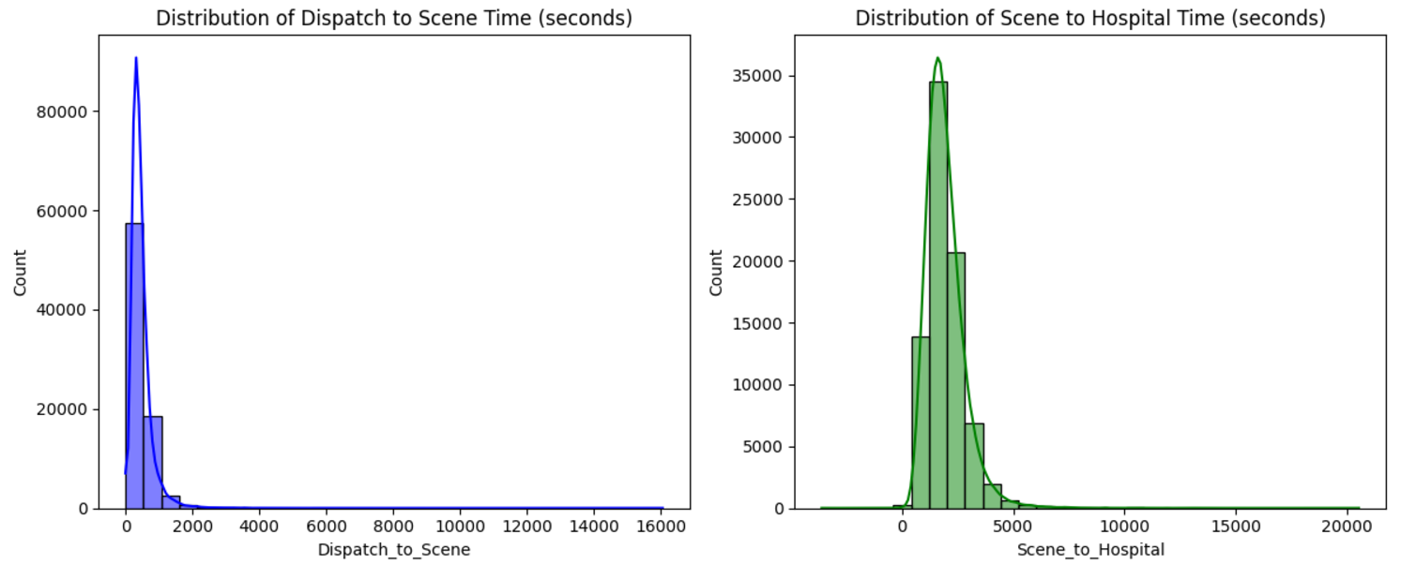
FREQUENCY DISTRIBUTION OF RESPONSE TIMES

Slide 11
The distribution is right-skewed, meaning there are many instances where the dispatch time is very short , but there are also some instances where it takes much longer.
This suggests that there might be some variability in dispatch times, possibly due to factors like call volume, staffing levels, or system issues.
Distribution of Dispatch to Scene Time

Slide 12
This distribution also appears to be right-skewed, with a long tail towards higher values. This indicates that while most transports are relatively quick, there are some cases where it takes significantly longer to get a patient to the hospital.
Factors like traffic conditions, distance to the hospital, and patient condition could contribute to this variation.
Distribution of Scene to Hospital Time

Slide 13
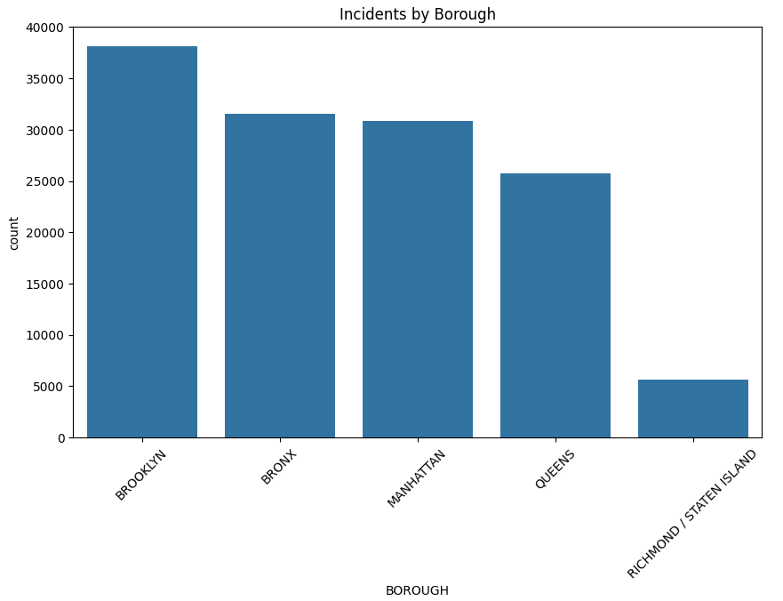
GEOGRAPHICAL ANALYSIS

Slide 14
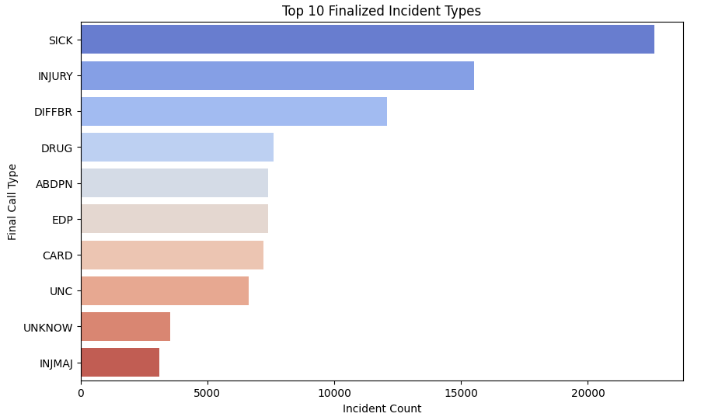
TOP 10 DIFFERENT INCIDENT TYPES

Slide 15
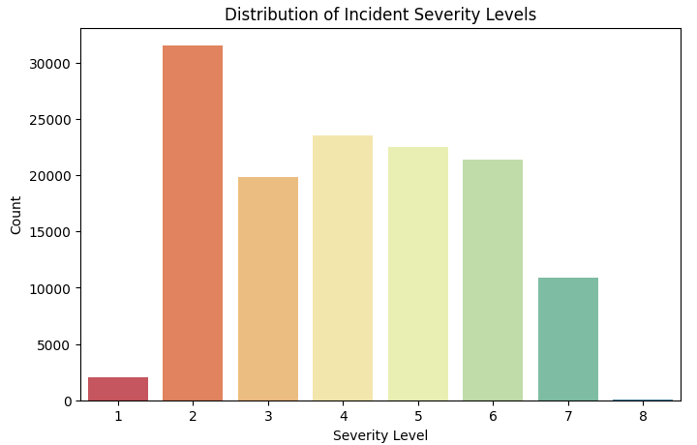
SEVERITY DISTRIBUTION

Slide 16
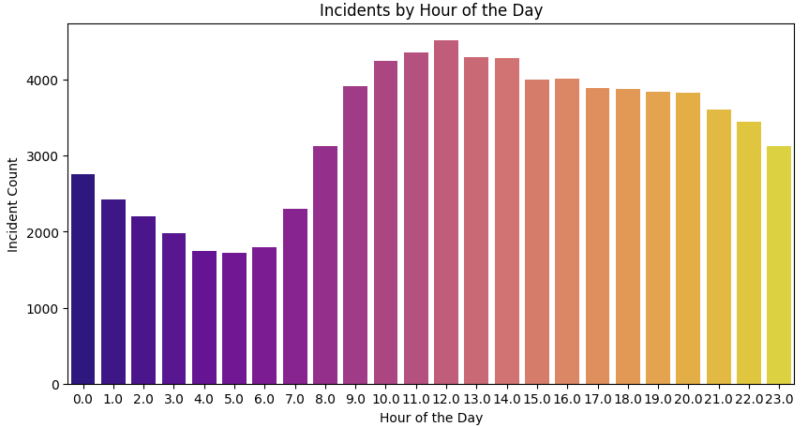
TEMPORAL PATTERNS

Slide 17
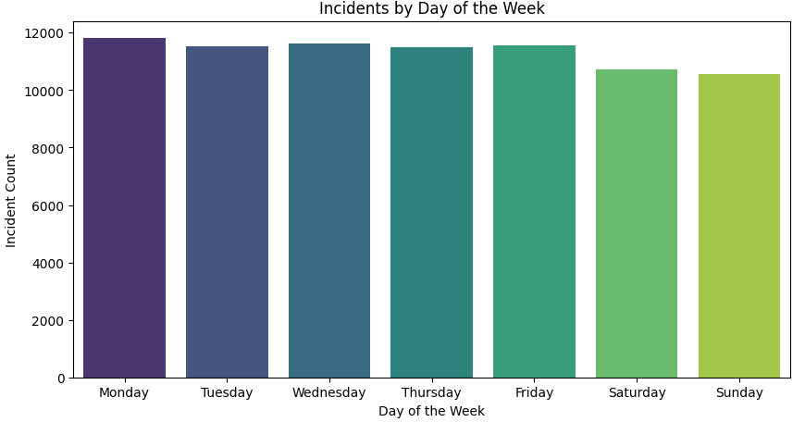
TEMPORAL PATTERNS

Slide 18
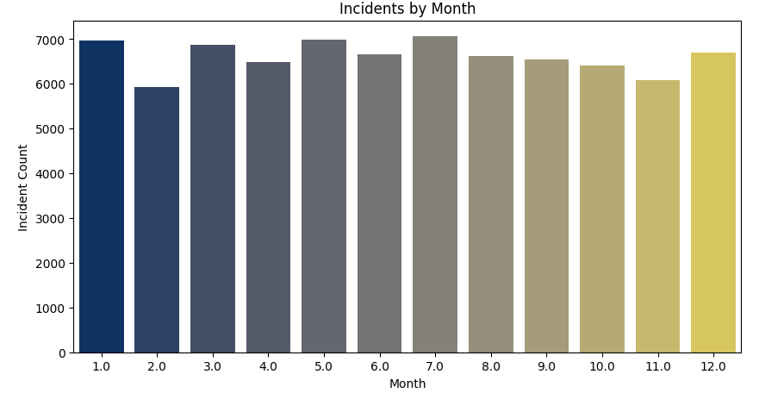
TEMPORAL PATTERNS

Slide 19
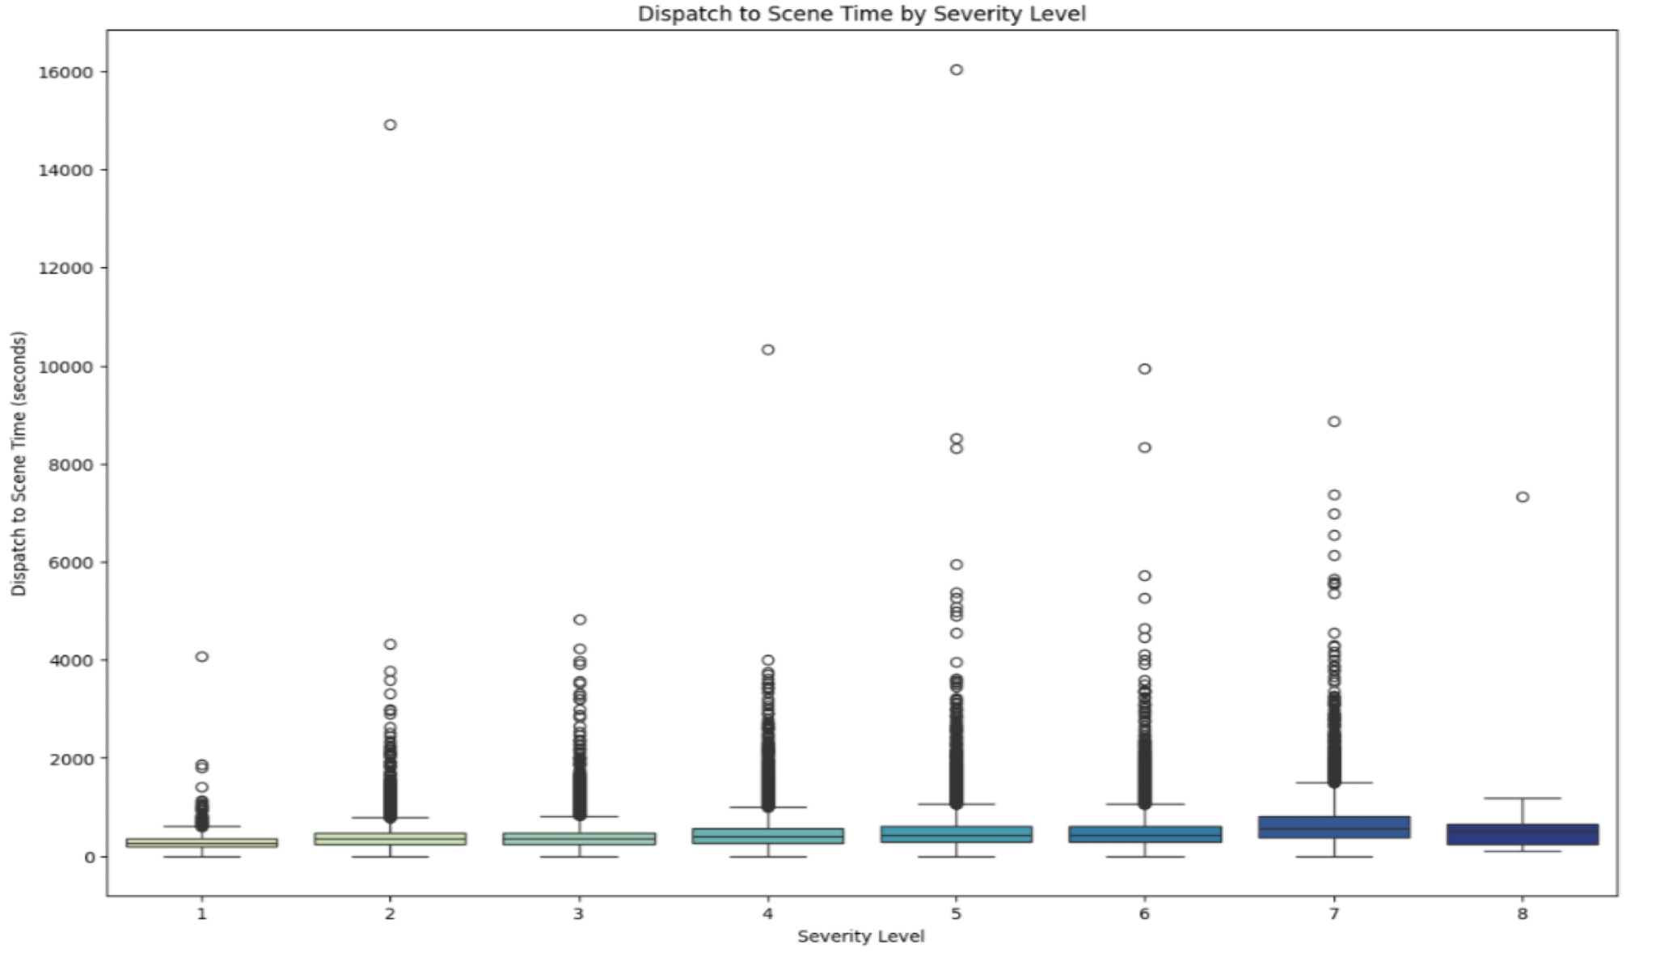
EXAMINE IF HIGHER-SEVERITY INCIDENTS TEND TO HAVE QUICKER RESPONSE TIMES

Slide 20
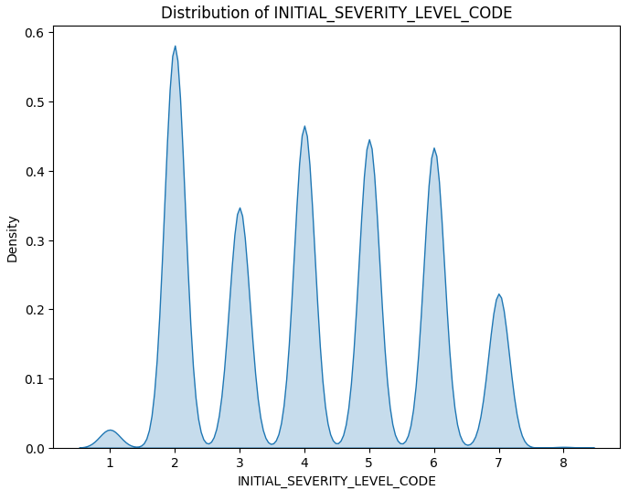
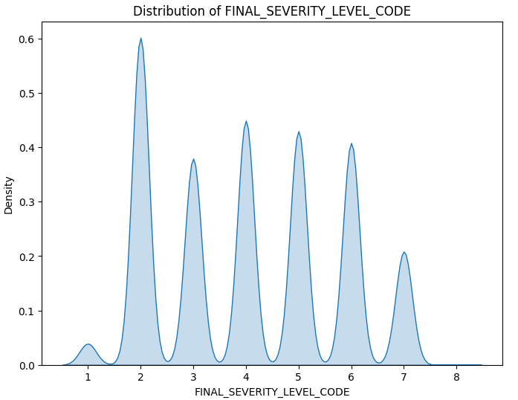
Kernel Density Estimation (KDE) Plot

Slide 21
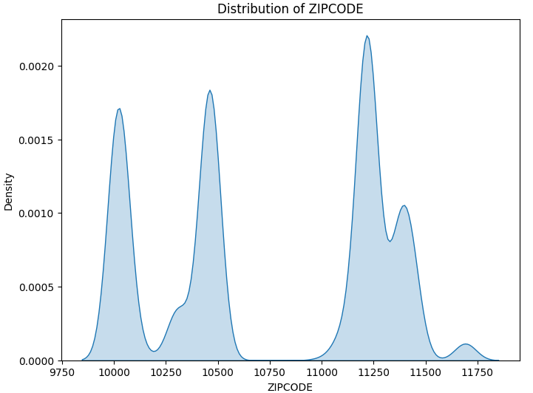
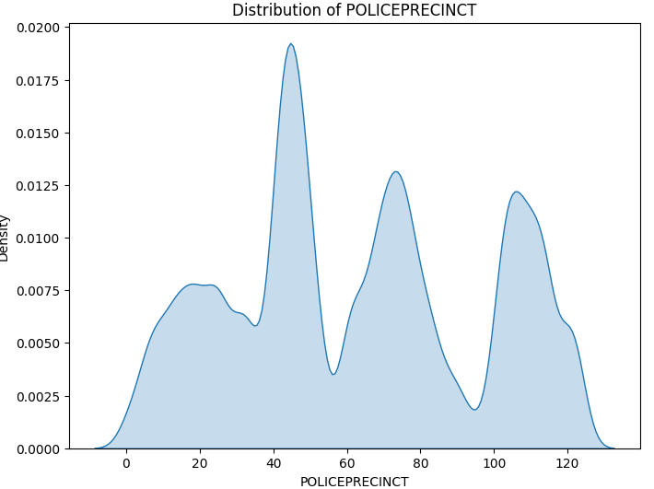
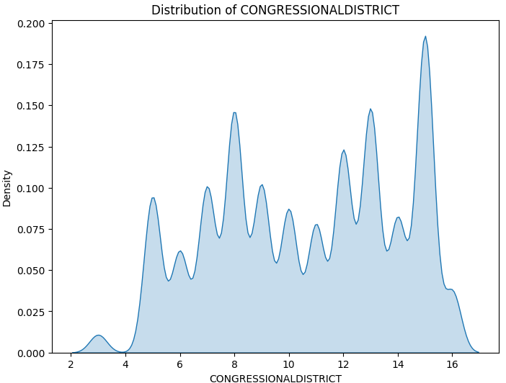
Kernel Density Estimation (KDE) Plot

Slide 22
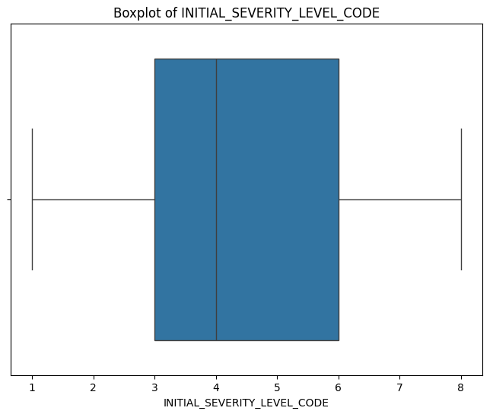
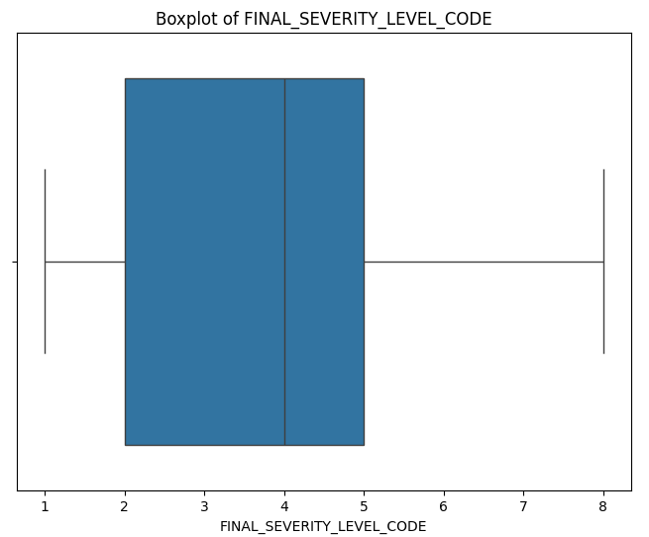
BOXPLOTS FOR OUTLIER DETECTION

Slide 23
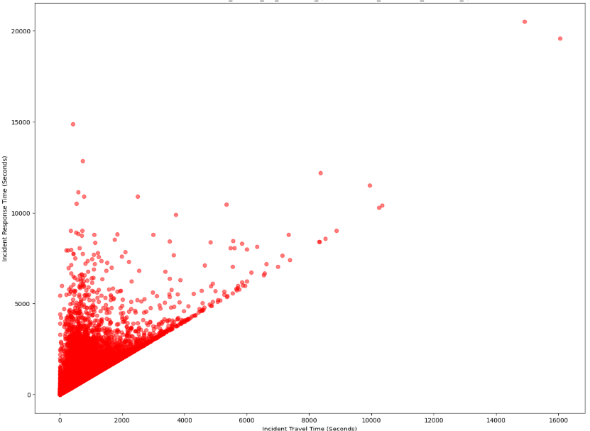
SCATTER PLOT
The overall trend shows a positive correlation between Incident Travel Time and Incident Response Time. This means that as the travel time increases, the response time also tends to increase. This is intuitive, as longer travel times naturally lead to longer overall response times.
There are some data points scattered towards the upper right corner of the plot. These outliers represent incidents with significantly longer travel and response times.

Slide 24
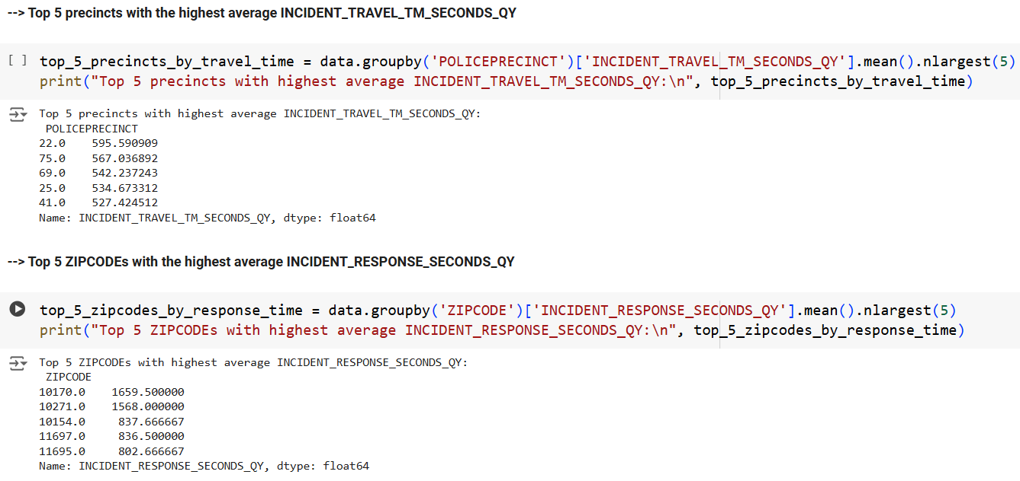

Slide 25
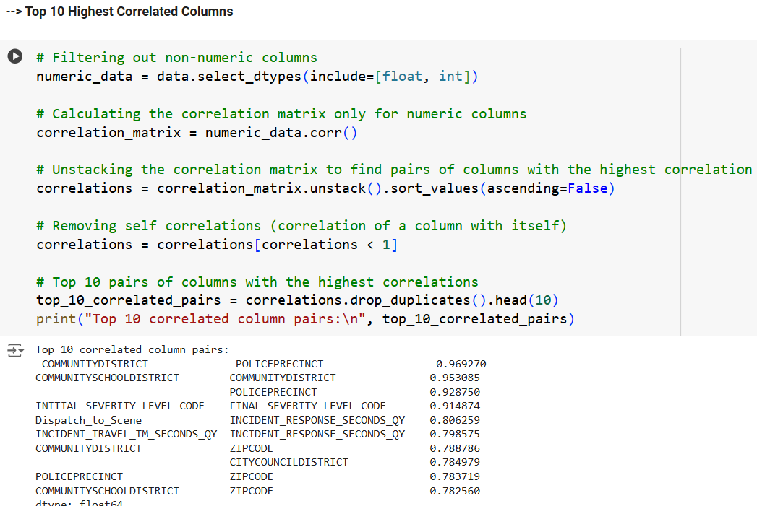

Slide 26
MODEL BUILDING
Data Preprocessing:
Datetime Parsing:
Extracted hour_of_day, day_of_week, & month from incident timestamps.
Calculated total_incident_duration in minutes.
Feature Filtering:
Retained records with valid response times (1–600 seconds).
Feature Engineering:
Categorized nominal, ordinal, and numerical features.
Handling Missing Values:
Dropped rows with NaN values.

Slide 27
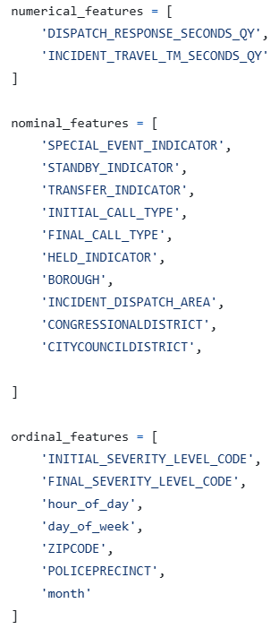
MODEL BUILDING
Feature Categories:
Numerical Features:
DISPATCH_RESPONSE_SECONDS_QY
INCIDENT_TRAVEL_TM_SECONDS_QY
Ordinal Features:
INITIAL_SEVERITY_LEVEL_CODE,
FINAL_SEVERITY_LEVEL_CODE,
Nominal Features:
Event indicators, call types, boroughs, etc.
Target Variable:
INCIDENT_RESPONSE_SECONDS_QY

Slide 28
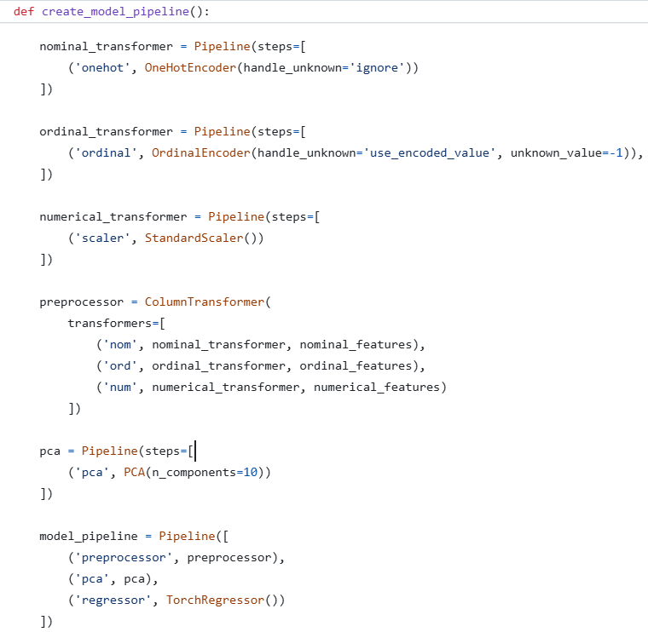
MODEL BUILDING
Model Pipeline Architecture
Preprocessing Pipeline:
Numerical: Standard Scaler
Nominal: OneHotEncoder
Ordinal: OrdinalEncoder
Dimensionality Reduction:
PCA (10 components)
Regressor:
PyTorch-based TorchRegressor
Feed-forward neural network (FFN)

Slide 29
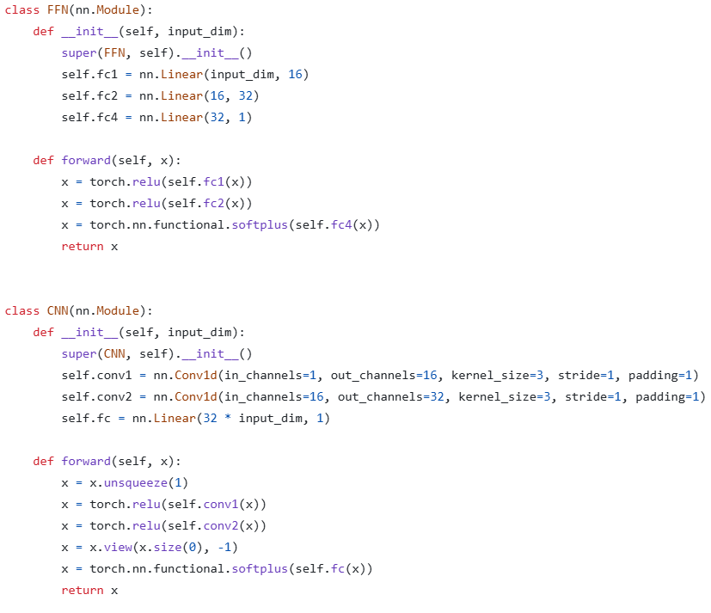
MODEL BUILDING
Custom Regressor Details
Network Architecture:
Input → FC (16 nodes) → FC (32 nodes)
→ Output
Activation: ReLU, Final Layer: SoftPlus
Training:
Loss Function: Mean Squared Error
Optimizer: Adam (Learning rate: 0.01)
Epochs: 1000

Slide 30
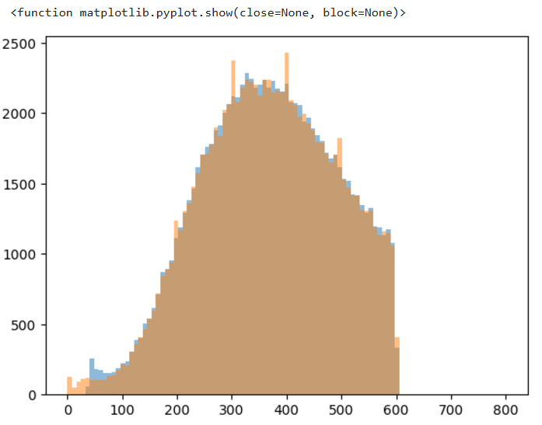
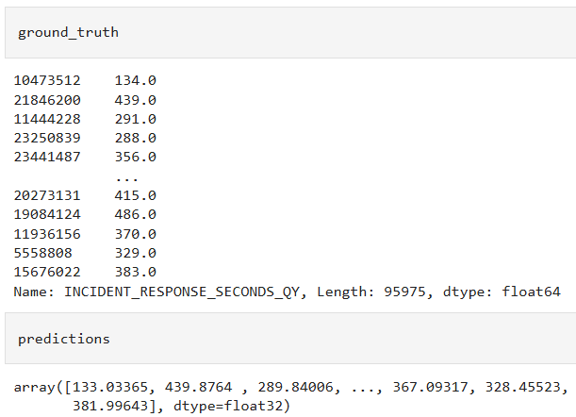
MODEL EVALUATION
Root Mean Square Error (RMSE): 3.22 seconds
R2 Score: 0.999

Slide 31
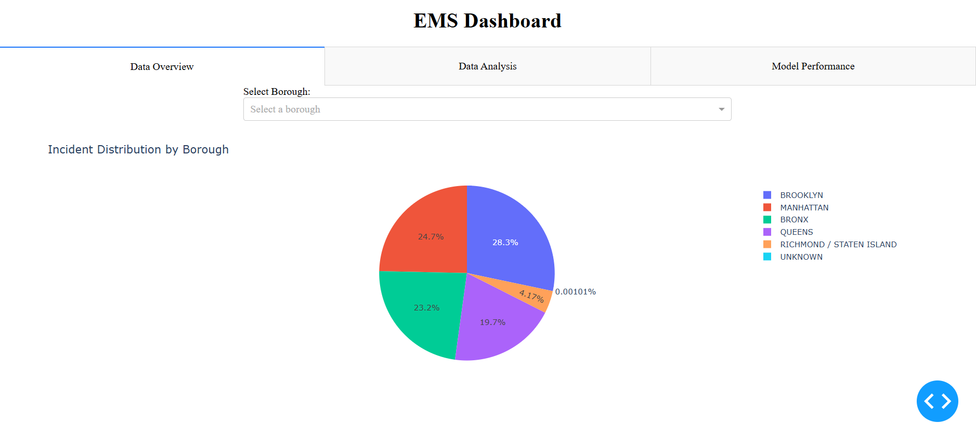
Dashboard for Non-Technical Stakeholders

Slide 32
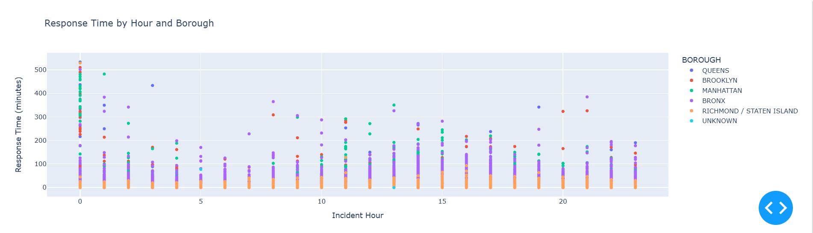

Slide 33
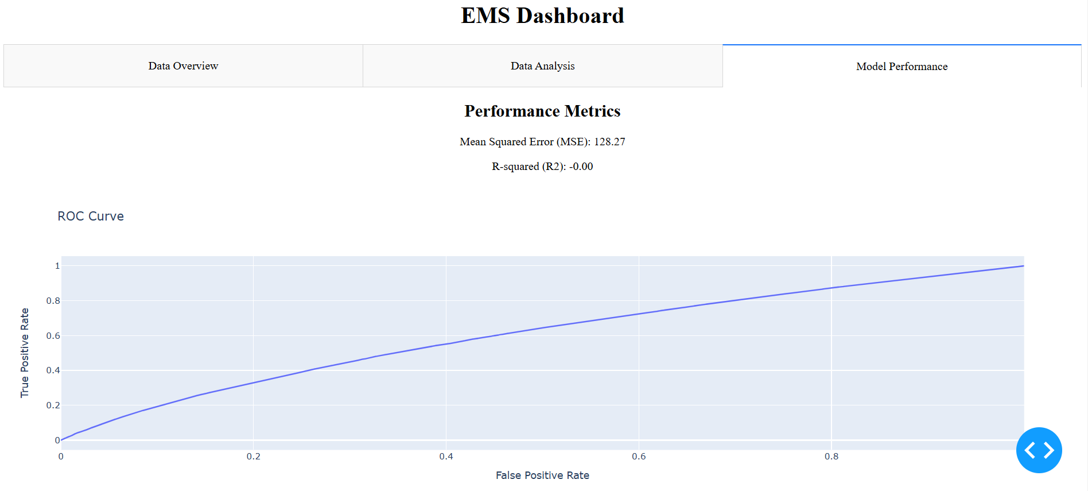

Slide 34

FUTURE SCOPE
Integration with Real-Time Systems:
Implement the model in live incident response systems for real-time predictions. Continuously update the model with new data to improve accuracy and adapt to changing trends.
Advanced Feature Engineering:
Include additional features such as traffic conditions, weather data, and population density to enhance prediction accuracy.
Explainable AI (XAI) Integration:
Incorporate explainability tools (e.g., SHAP, LIME) to understand feature contributions.
Model Optimization and Ensemble Learning:
Explore ensemble models like Random Forest, Gradient Boosting, or hybrid approaches combining neural networks with traditional methods. Experiment with hyperparameter tuning using Bayesian optimization or grid search.

Slide 35
THANK YOU

